Slide 1
成绩组成
理论课成绩（COD）
• Homework Sets - 20%
• Two Quizzes (随堂测验） - 20%
• Two Projects - 20%
• Finial Exam - 40%
《计算机组成与设计》总评成绩:
•COD * (3.0/3.5)+ Lab score * (0.5/3.5)

Slide 2
Chapter 1
Computer Abstractions and Technology

Slide 3
The Computer Revolution
§1.1 Introduction
Progress in computer technology
  Underpinned by Moore’s Law
Makes novel applications feasible
  Computers in automobiles
  Cell phones
  Human genome project
  World Wide Web
  Search Engines
Computers are pervasive

Slide 4
Classes of Computers
Desktop computers
  General purpose, variety of software
  Subject to cost/performance tradeoff
Server computers
  Network based
  High capacity, performance, reliability
  Range from small servers to building sized
Embedded computers
  Hidden as components of systems
  Stringent power/performance/cost constraints
Post-PC Era
  personal mobile device (PMD)
  Cloud Computing

Slide 5
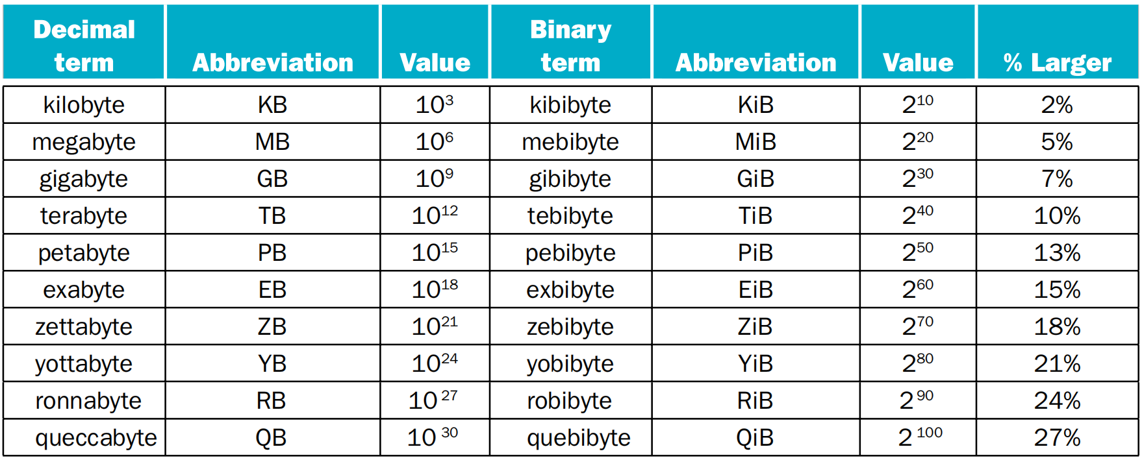
2^{X} vs. 10^{Y} bytes ambiguity
the full range of decimal and binary values and names

Slide 6
What You Will Learn
How programs are translated into the machine language
  And how the hardware executes them
The hardware/software interface
What determines program performance
  And how it can be improved
How hardware designers improve performance and energy efficiency
What is parallel processing

Slide 7
Understanding Performance
Algorithm
  Determines number of operations executed
Programming language, compiler, architecture
  Determine number of machine instructions executed per operation
Processor and memory system
  Determine how fast instructions are executed
I/O system (including OS)
  Determines how fast I/O operations are executed

Slide 8
Seven Design Ideas
Use Abstraction to Simplify Design
Make the Common Case Fast
Performance via Parallelism
Performance via Pipelining
Performance via Prediction
Hierarchy of Memories
Dependability via Redundancy
§1.2 Seven Great Ideas in Computer Architecture

Slide 9
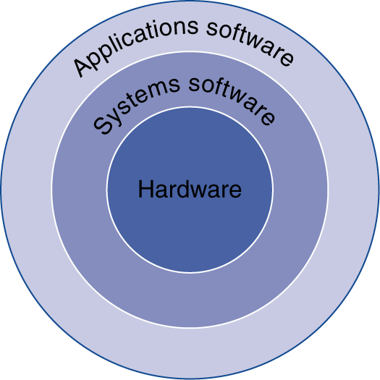
Below Your Program
Application software
  Written in high-level language
System software
  Compiler: translates HLL code to machine code
  Operating System: service code
    Handling input/output
    Managing memory and storage
    Scheduling tasks & sharing resources
Hardware
  Processor, memory, I/O controllers
§1.3 Below Your Program

Slide 10
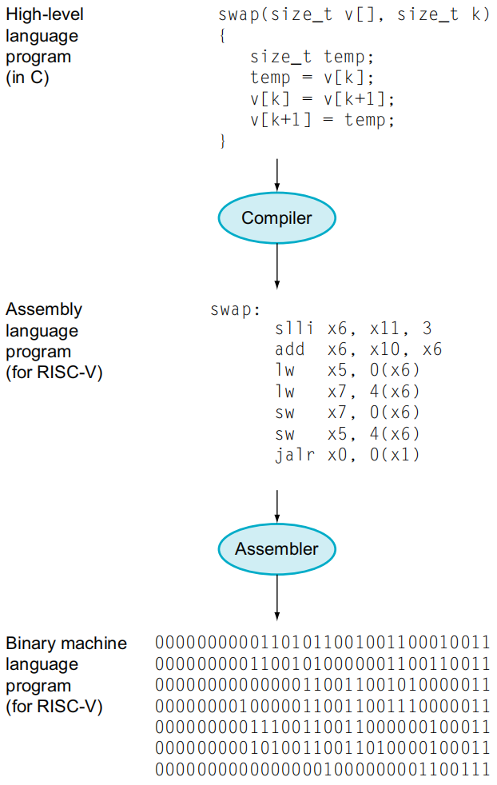
Levels of Program Code
High-level language
  Level of abstraction closer to problem domain
  Provides for productivity and portability
Assembly language
  Textual representation of instructions
Hardware representation
  Binary digits (bits)
  Encoded instructions and data

Slide 11
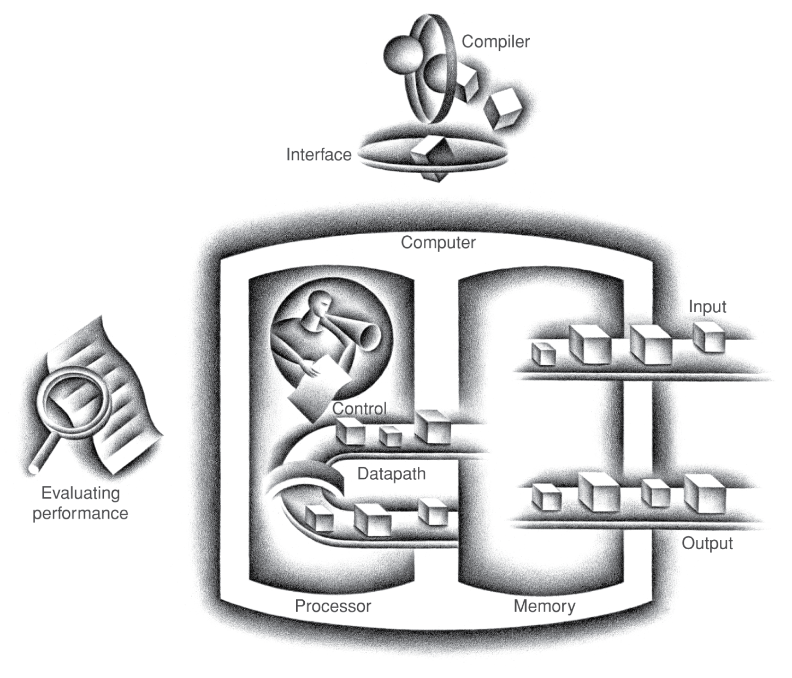
Components of a Computer
Same components for
all kinds of computer
  Desktop, server,
  embedded,PMD
Input/output includes
  User-interface devices
    Display, keyboard, mouse,Touchscreen
  Storage devices
    Hard disk, CD/DVD, flash
  Network adapters
    For communicating with other computers
§1.4 Under the Covers
The BIG Picture

Slide 12
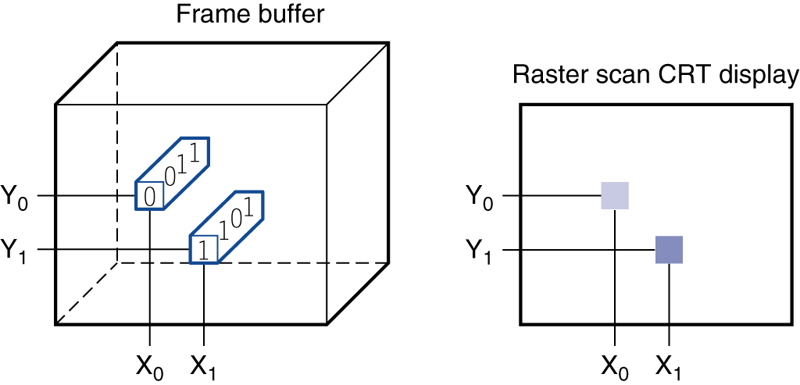
Through the Looking Glass
LCD screen: picture elements (pixels)
  Mirrors content of frame buffer memory

Slide 13
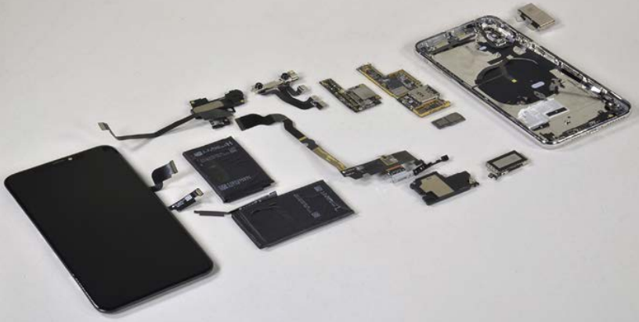
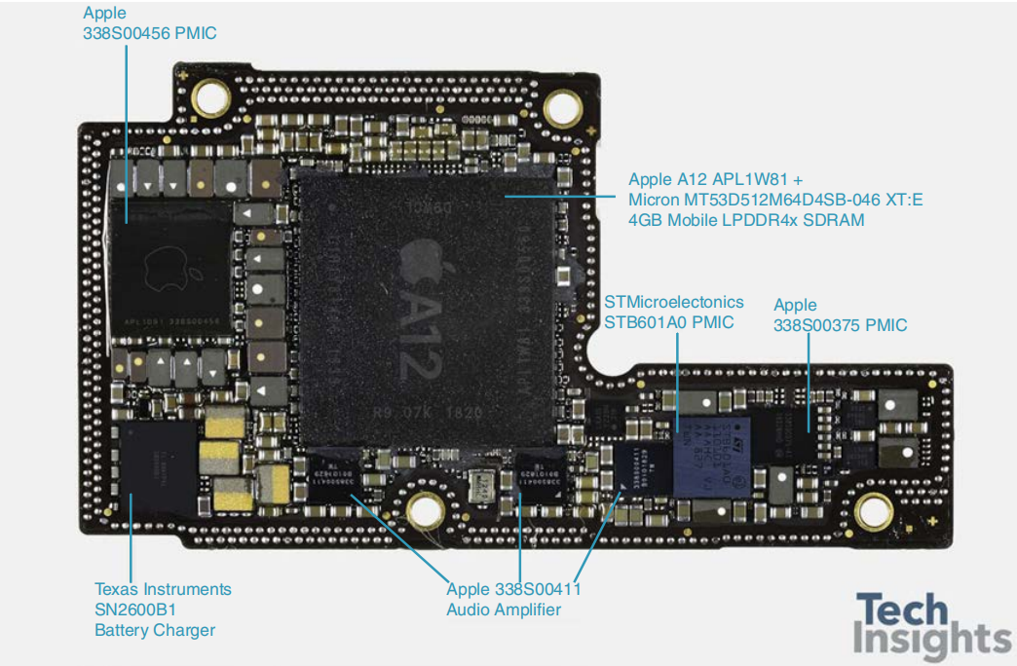
Opening the Box
Memory : contain instructions and data of a program when running
  DRAM(dynamic random-access)

Slide 14
Inside the Processor (CPU)
Datapath: performs operations on data
Control: sequences datapath, memory, ...
Cache memory
  Small fast SRAM memory for immediate access to data

Slide 15
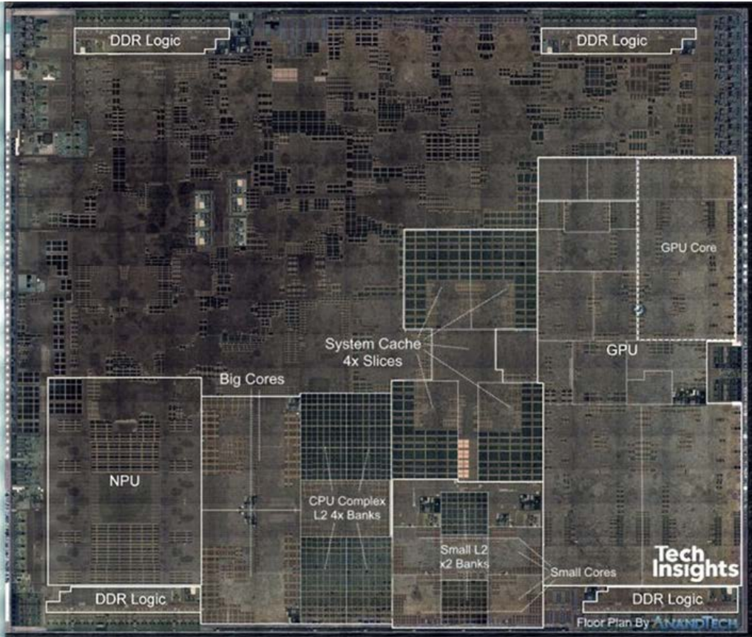
Inside the Processor
A12: 7-nm process

Slide 16
Abstractions
The BIG Picture
Abstraction helps us deal with complexity
  Hide lower-level detail
Instruction set architecture (ISA)
  The hardware/software interface
Application binary interface
  The ISA plus system software interface
Implementation
  The details underlying and interface

Slide 17
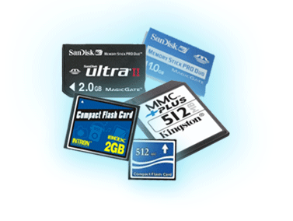
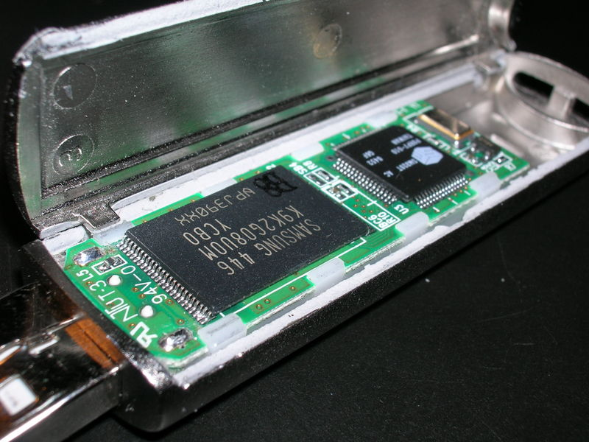
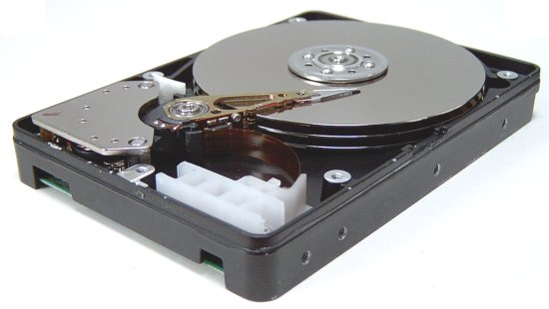
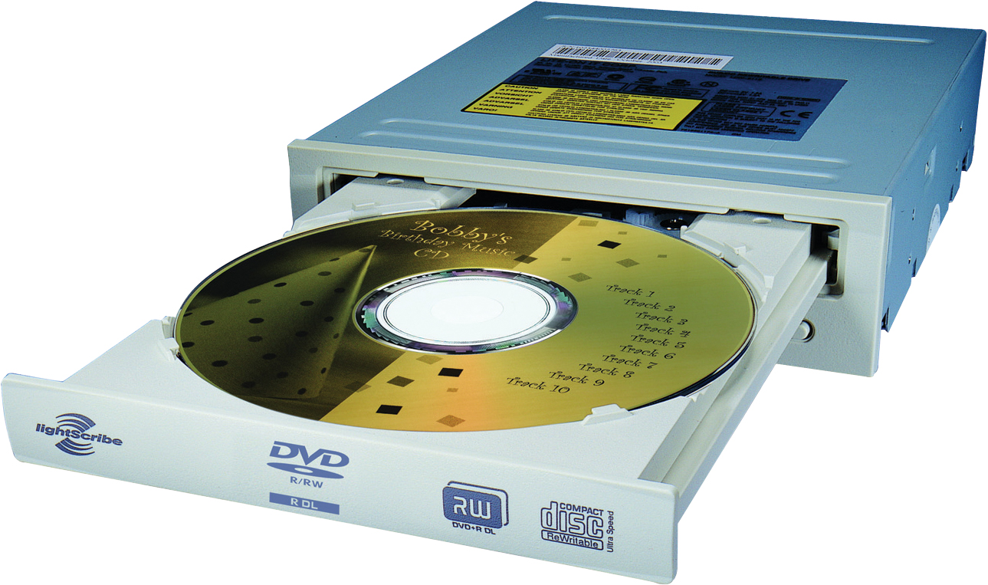
A Safe Place for Data
Volatile main memory
  Loses instructions and data when power off
Non-volatile secondary memory
  Magnetic disk
  Flash memory
  Optical disk (CDROM, DVD)

Slide 18

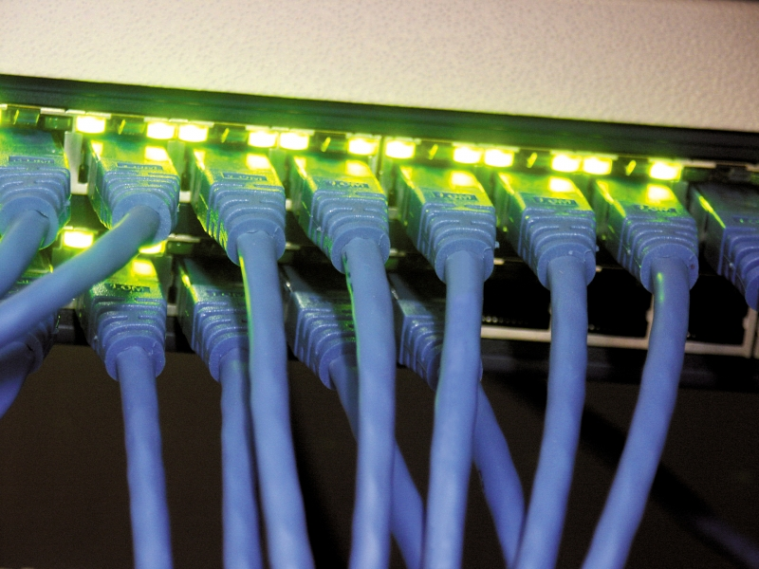
Networks
Communication and resource sharing
Local area network (LAN): Ethernet
  Within a building
Wide area network (WAN): the Internet
Wireless network: WiFi, Bluetooth

Slide 19
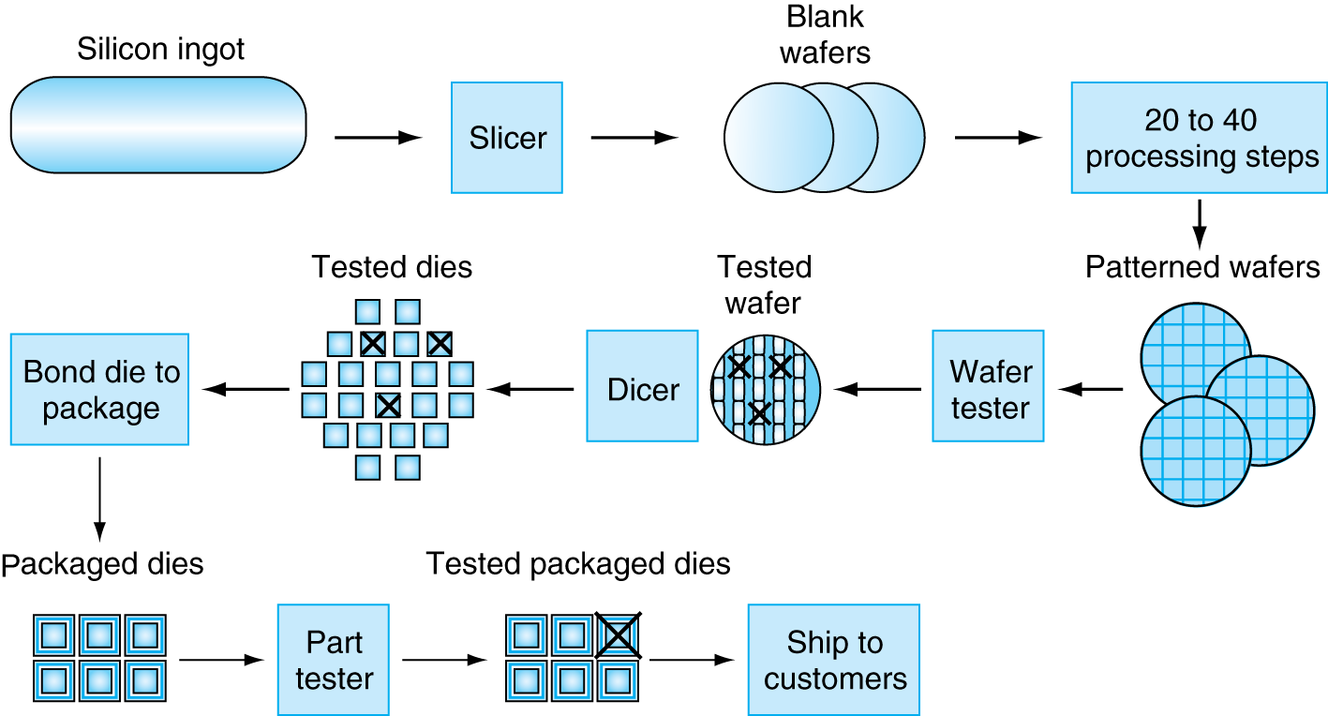
Manufacturing ICs
§1.5 Technologies for Building Processors and Memory
Yield: proportion of working dies per wafer

Slide 20
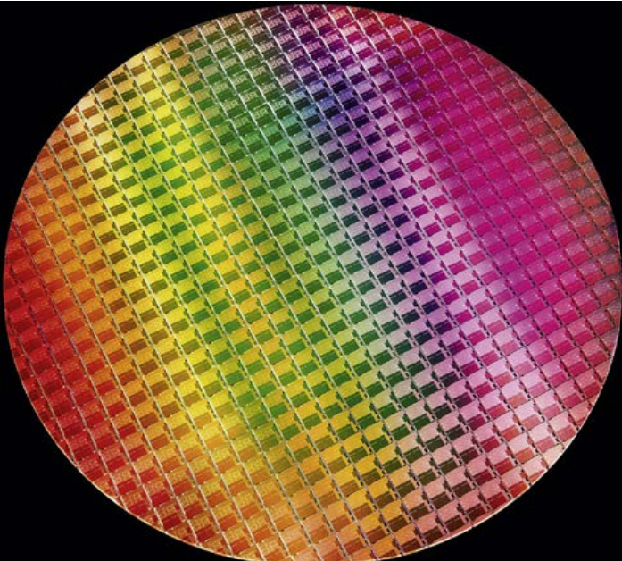
10th Gen Intel Wafer
12-inch (300mm) wafer, 506 chips, 10nm technology

Slide 21
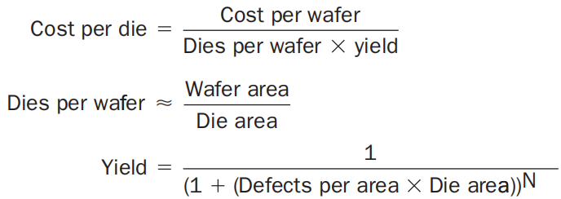
Integrated Circuit Cost
Nonlinear relation to area and defect rate
  Wafer cost and area are fixed
  Defect rate determined by manufacturing process
  Die area determined by architecture and circuit design

Slide 22
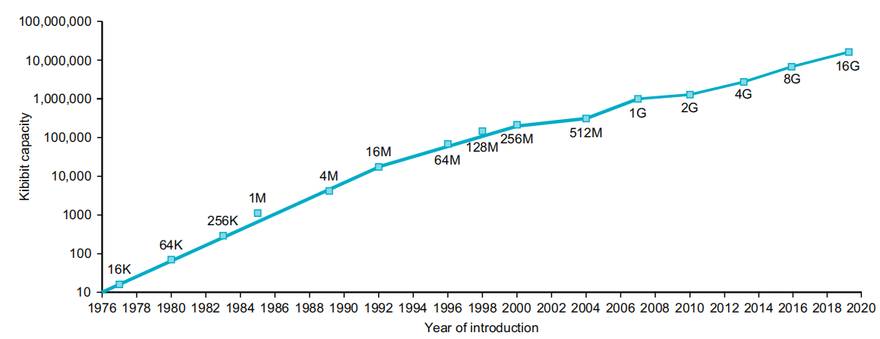
Technology Trends
Electronics technology continues to evolve
  Increased capacity and performance
  Reduced cost
DRAM capacity
Year | Technology | Relative performance/cost
1951 | Vacuum tube | 1
1965 | Transistor | 35
1975 | Integrated circuit (IC) | 900
1995 | Very large scale IC (VLSI) | 2,400,000
2020 | Ultra large scale IC | 500,000,000,000

Slide 23
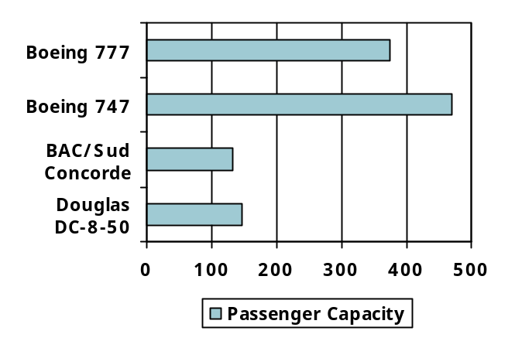
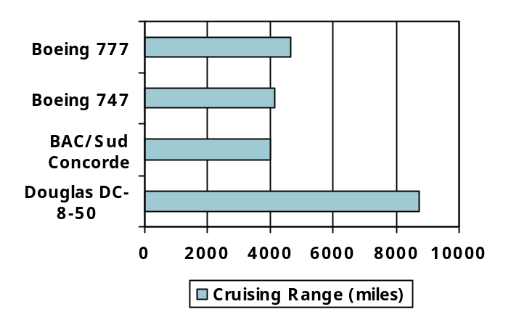
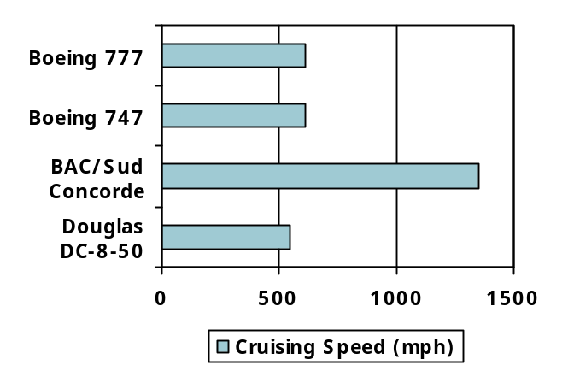
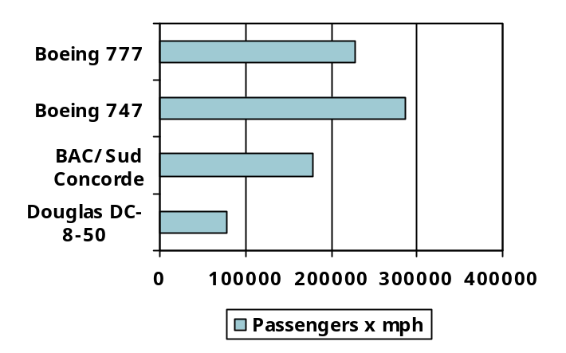
Defining Performance
§1.6 Performance
Which airplane has the best performance?

Slide 24
Response Time and Throughput
Response time
  How long it takes to do a task
Throughput
  Total work done per unit time
    e.g., tasks/transactions/… per hour
How are response time and throughput affected by
  Replacing the processor with a faster version?
  Adding more processors?
We’ll focus on response time for now…

Slide 25
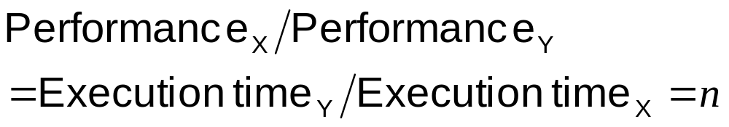
Relative Performance
Define Performance = 1/Execution Time
“X is n time faster than Y”
Example: time taken to run a program
  10s on A, 15s on B
  Execution Time_{B} / Execution Time_{A}
  = 15s / 10s = 1.5
  So A is 1.5 times faster than B

Slide 26
Measuring Execution Time
Elapsed time
  Total response time, including all aspects
    Processing, I/O, OS overhead, idle time
  Determines system performance
CPU time
  Time spent processing a given job
    Discounts I/O time, other jobs’ shares
  Comprises user CPU time and system CPU time
  Different programs are affected differently by CPU and system performance

Slide 27
CPU Clocking
Operation of digital hardware governed by a constant-rate clock
Clock period
Clock (cycles)
Data transfer
and computation
Update state
Clock period: duration of a clock cycle
  e.g., 250ps = 0.25ns = 250×10^{–12}s
Clock frequency (rate): cycles per second
  e.g., 4.0GHz = 4000MHz = 4.0×10⁹Hz

Slide 28
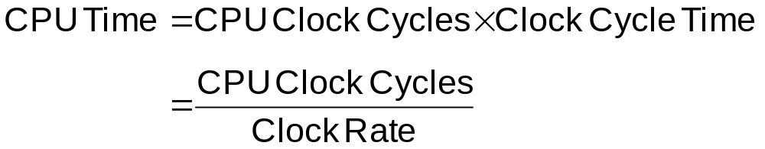
CPU Time
Performance improved by
  Reducing number of clock cycles
  Increasing clock rate
  Hardware designer must often trade off clock rate against cycle count

Slide 29
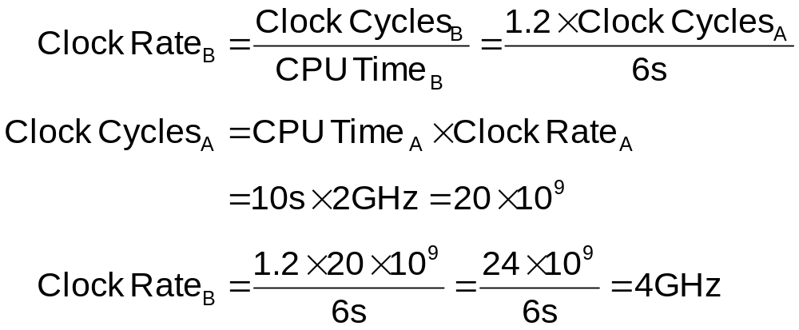
CPU Time Example
Computer A: 2GHz clock, 10s CPU time
Designing Computer B
  Aim for 6s CPU time
  Can do faster clock, but causes 1.2 × clock cycles
How fast must Computer B clock be?

Slide 30
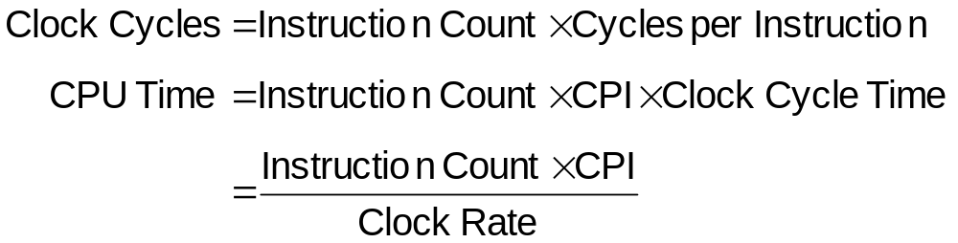
Instruction Count and CPI
Instruction Count for a program
  Determined by program, ISA and compiler
Average cycles per instruction
  Determined by CPU hardware
  If different instructions have different CPI
    Average CPI affected by instruction mix

Slide 31
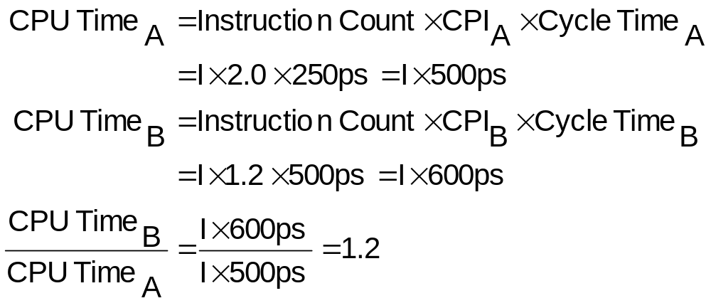
CPI Example
Computer A: Cycle Time = 250ps, CPI = 2.0
Computer B: Cycle Time = 500ps, CPI = 1.2
Same ISA
Which is faster, and by how much?
A is faster…
…by this much

Slide 32
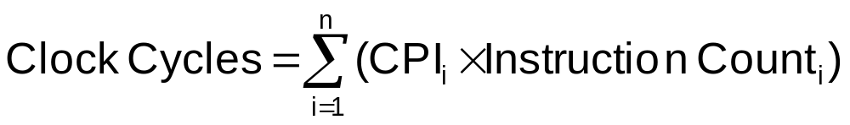
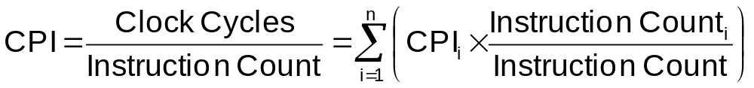
CPI in More Detail
If different instruction classes take different numbers of cycles
Weighted average CPI
Relative frequency

Slide 33
CPI Example
Alternative compiled code sequences using instructions in classes A, B, C
Class | A | B | C
CPI for class | 1 | 2 | 3
IC in sequence 1 | 2 | 1 | 2
IC in sequence 2 | 4 | 1 | 1
Sequence 1: IC = 5
  Clock Cycles
  = 2×1 + 1×2 + 2×3
  = 10
  Avg. CPI = 10/5 = 2.0
Sequence 2: IC = 6
  Clock Cycles
  = 4×1 + 1×2 + 1×3
  = 9
  Avg. CPI = 9/6 = 1.5

Slide 34
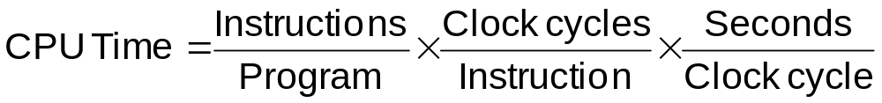
Performance Summary
The BIG Picture
Performance depends on
  Algorithm: affects IC, possibly CPI
  Programming language: affects IC, CPI
  Compiler: affects IC, CPI
  Instruction set architecture: affects IC, CPI, T_{c}

Slide 35
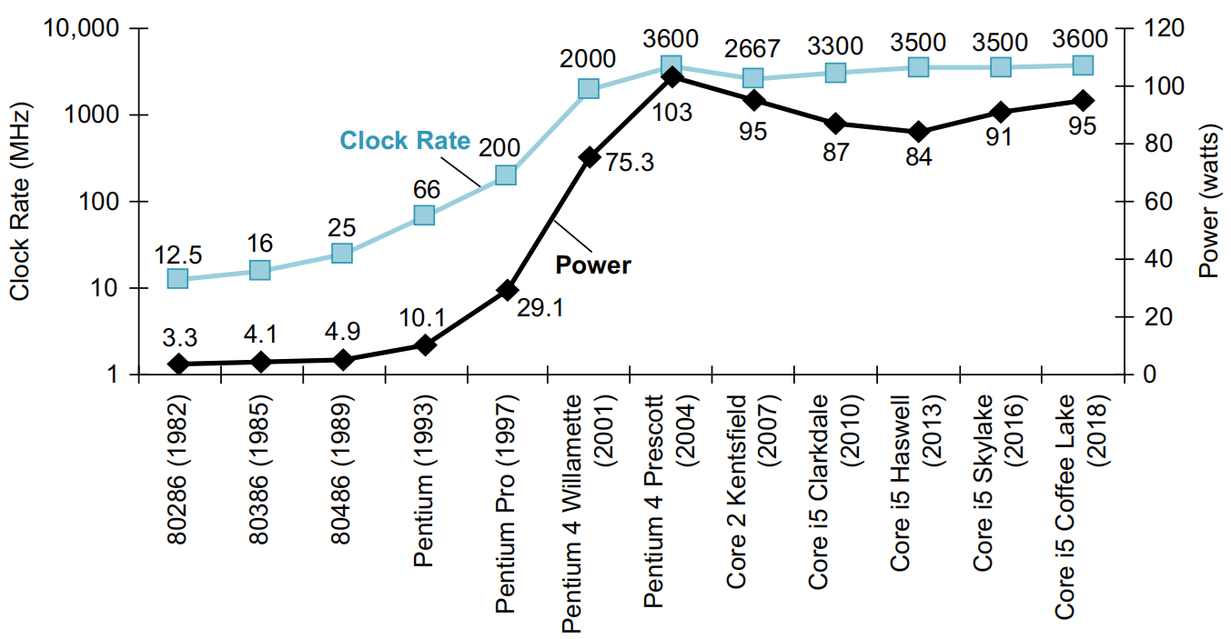
Power Trends
§1.7 The Power Wall
In CMOS IC technology
×30
5V → 1V
×1000

Slide 36
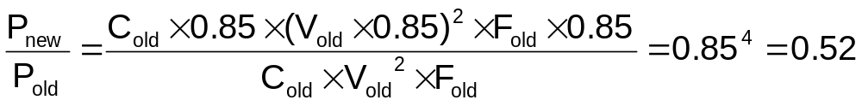
Reducing Power
Suppose a new CPU has
  85% of capacitive load of old CPU
  15% voltage and 15% frequency reduction
The power wall
  We can’t reduce voltage further: leakage
  We can’t remove more heat
How else can we improve performance?

Slide 37
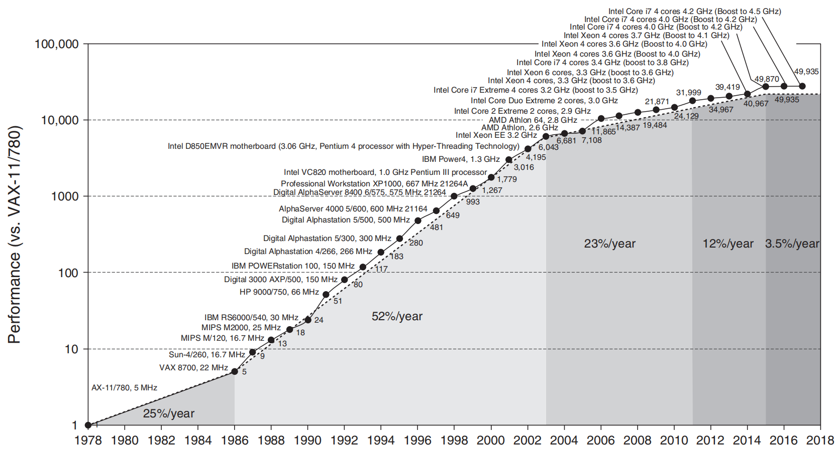
Uniprocessor Performance
§1.8 The Sea Change: The Switch to Multiprocessors
Constrained by power, instruction-level parallelism, memory latency

Slide 38
Multiprocessors
Multicore microprocessors
  More than one processor per chip
Requires explicitly parallel programming
  Compare with instruction level parallelism
    Hardware executes multiple instructions at once
    Hidden from the programmer
  Hard to do
    Programming for performance
    Load balancing
    Optimizing communication and synchronization

Slide 39
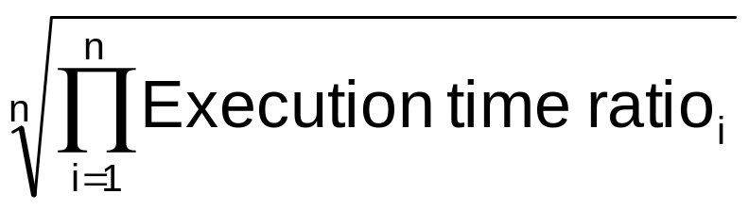
SPEC CPU Benchmark
Programs used to measure performance
  Supposedly typical of actual workload
Standard Performance Evaluation Corp (SPEC)
  Develops benchmarks for CPU, I/O, Web, …
SPEC CPU2017
  Elapsed time to execute a selection of programs
    Negligible I/O, so focuses on CPU performance
  Normalize relative to reference machine
  Summarize as geometric mean of performance ratios
    SPECspeed 2017 Integer and CFP2006 (floating-point)
§1.9-1.10 Benchmark and Going Faster

Slide 40
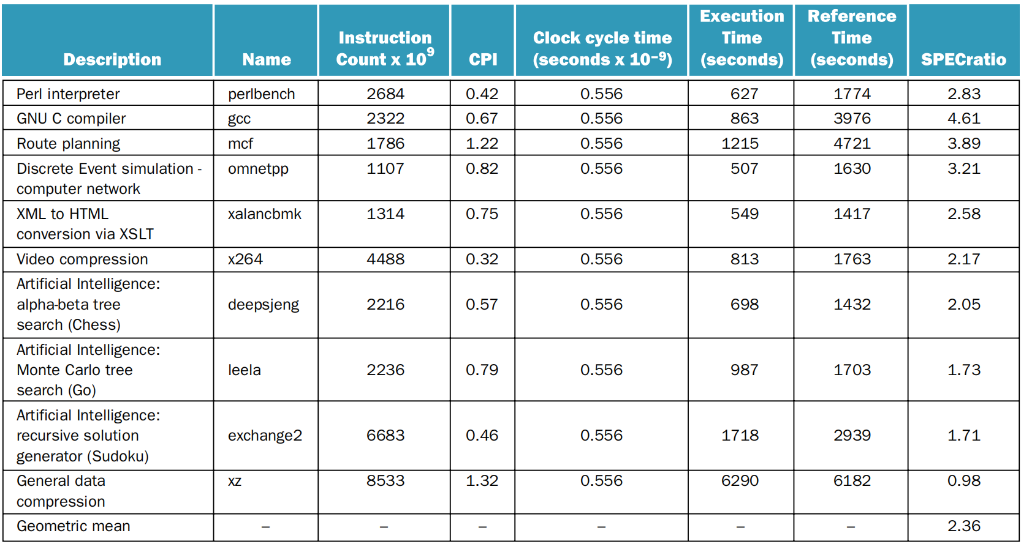
SPECspeed 2017 Integer for Intel Core i7

Slide 41
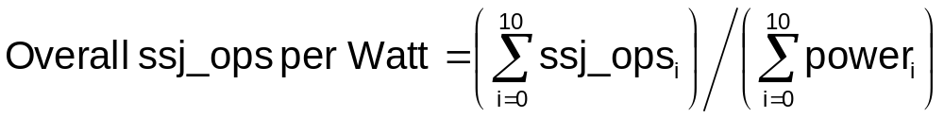
SPEC Power Benchmark
Power consumption of server at different workload levels
  Performance: ssj_ops/sec
  Power: Watts (Joules/sec)

Slide 42
SPECpower_ssj2008 for Intel Xeon Platinum8276L
Target Load % |  | Performance (ssj_ops/sec) |  | Average Power (Watts)
100% |  | 4,864,136 |  | 347
90% |  | 4,389,196 |  | 312
80% |  | 3,905,724 |  | 278
70% |  | 3,418,737 |  | 241
60% |  | 2,925,811 |  | 212
50% |  | 2,439,017 |  | 183
40% |  | 1,951,394 |  | 160
30% |  | 1,461,411 |  | 141
20% |  | 974,045 |  | 128
10% |  | 485,973 |  | 115
0% |  | 0 |  | 48
Overall sum |  | 26,815,444 |  | 2,165
∑ssj_ops/ ∑power |  |  |  | 12,385

Slide 43
Going Faster: Matrix Multiply in Python
C version : 200↑
data-level parallelism, in Chapter 3 : 8↑
instruction-level parallelism, in Chapter 4 : 2↑
memory hierarchy optimization, in Chapter 5 : 1.5↑
thread-level parallelism, in Chapter 6 : 12 to 17↑

Slide 44
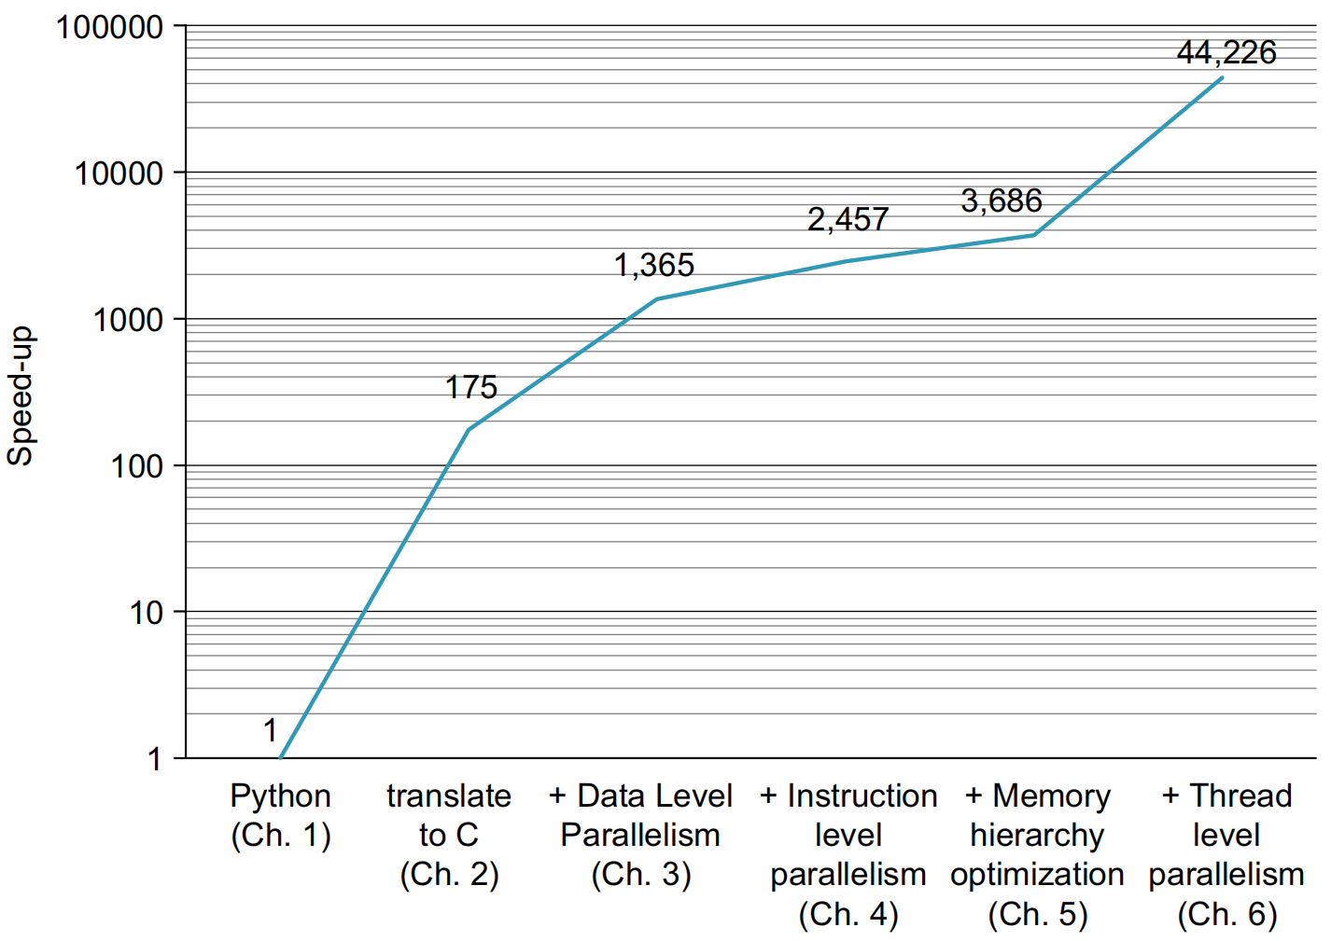
Optimizations

Slide 45

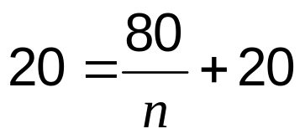
Pitfall: Amdahl’s Law
Improving an aspect of a computer and expecting a proportional improvement in overall performance
§1.11 Fallacies and Pitfalls
Example: multiply accounts for 80s/100s
  How much improvement in multiply performance to get 5× overall?
  Can’t be done!
Corollary: make the common case fast

Slide 46
Fallacy: Low Power at Idle
Look back at Intel Xeon Platinum 8276L power benchmark
  At 100% load: 347W
  At 30% load: 141W (40%)
  At 10% load: 115W (33%)
Google data center
  Mostly operates at 10% – 50% load
  At 100% load less than 1% of the time
Consider designing processors to make power proportional to load

Slide 47
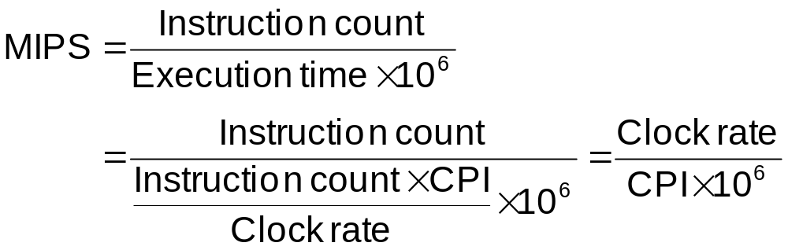
Pitfall: MIPS as a Performance Metric
MIPS: Millions of Instructions Per Second
  Doesn’t account for
    Differences in ISAs between computers
    Differences in complexity between instructions
  CPI varies between programs on a given CPU

Slide 48
Concluding Remarks
Cost/performance is improving
  Due to underlying technology development
Hierarchical layers of abstraction
  In both hardware and software
Instruction set architecture
  The hardware/software interface
Execution time: the best performance measure
Power is a limiting factor
  Use parallelism to improve performance
§1.12 Concluding Remarks

